Slide 1
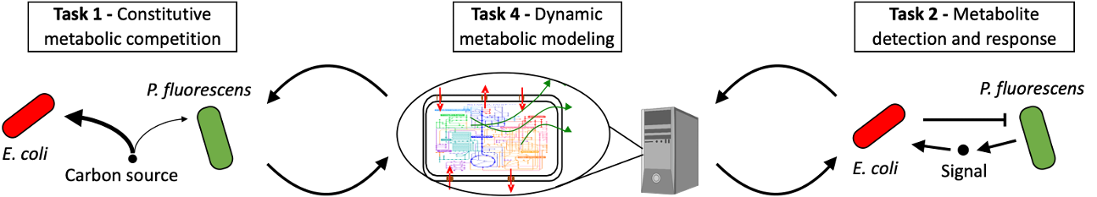
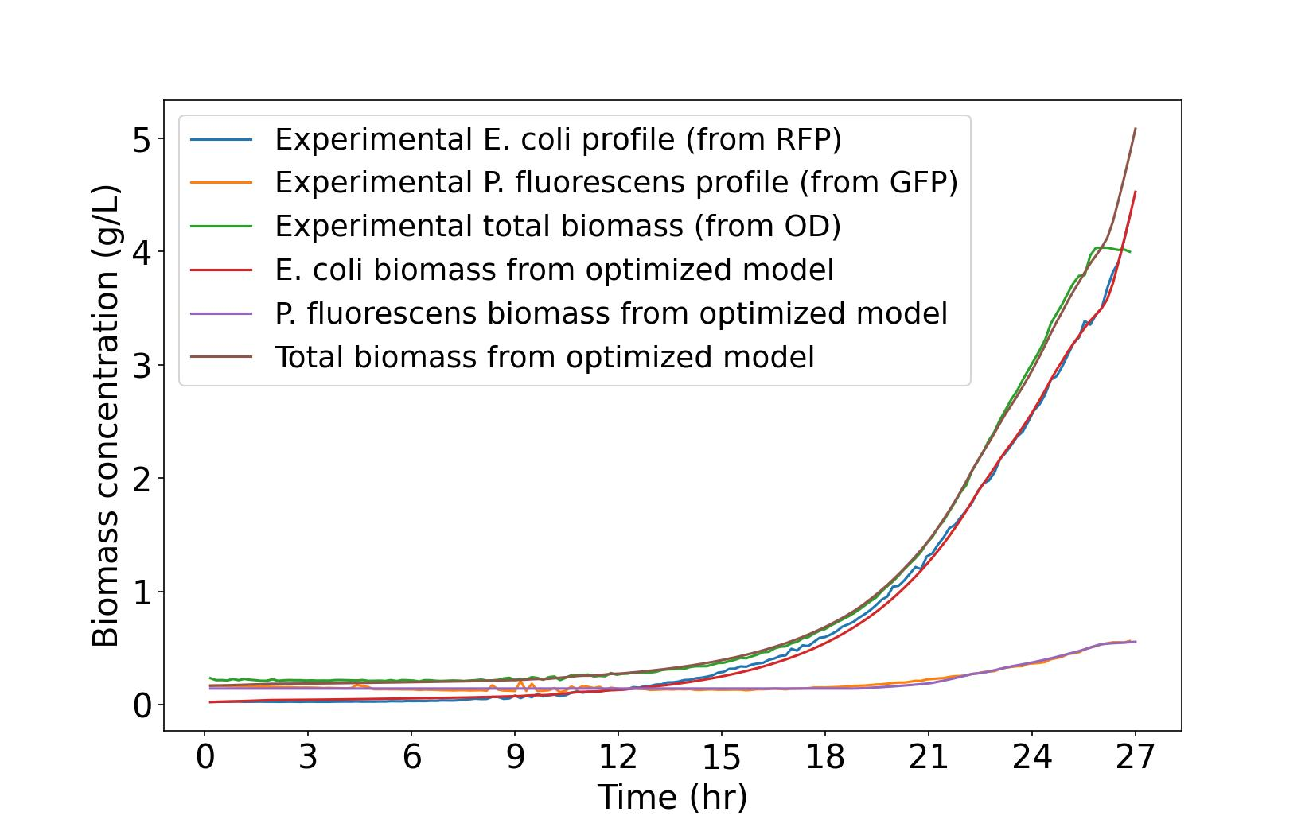
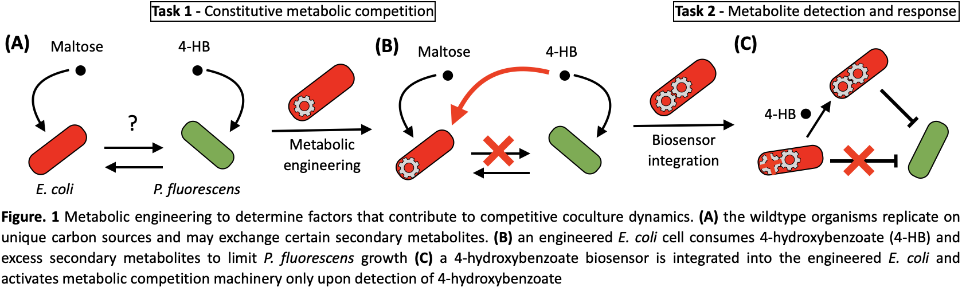
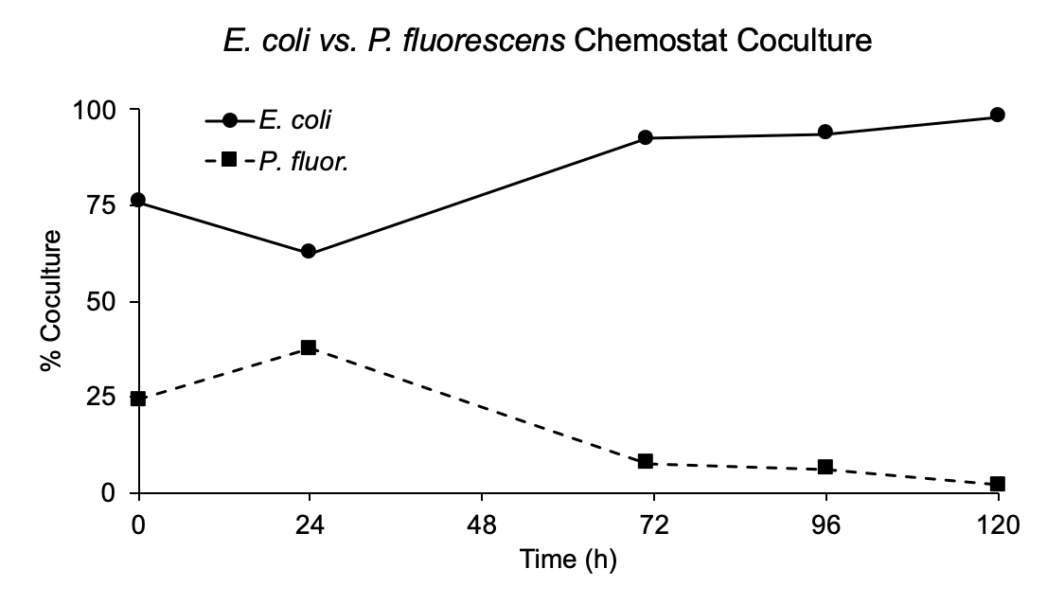
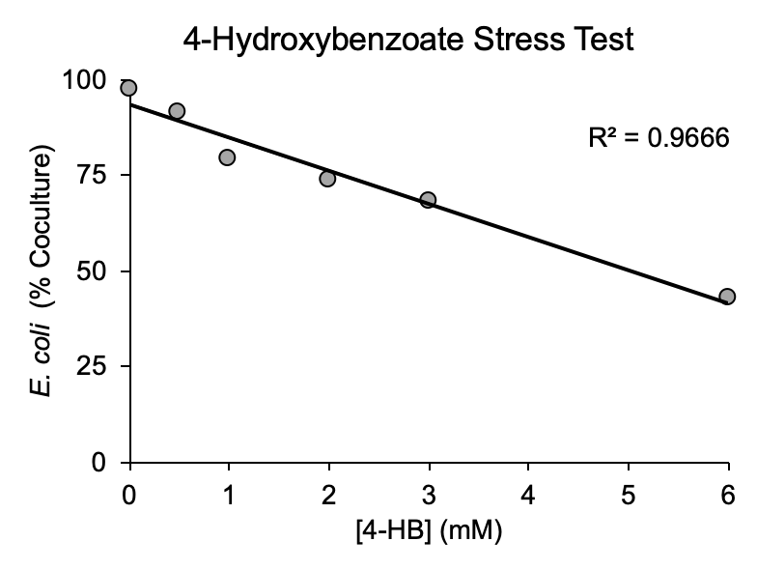
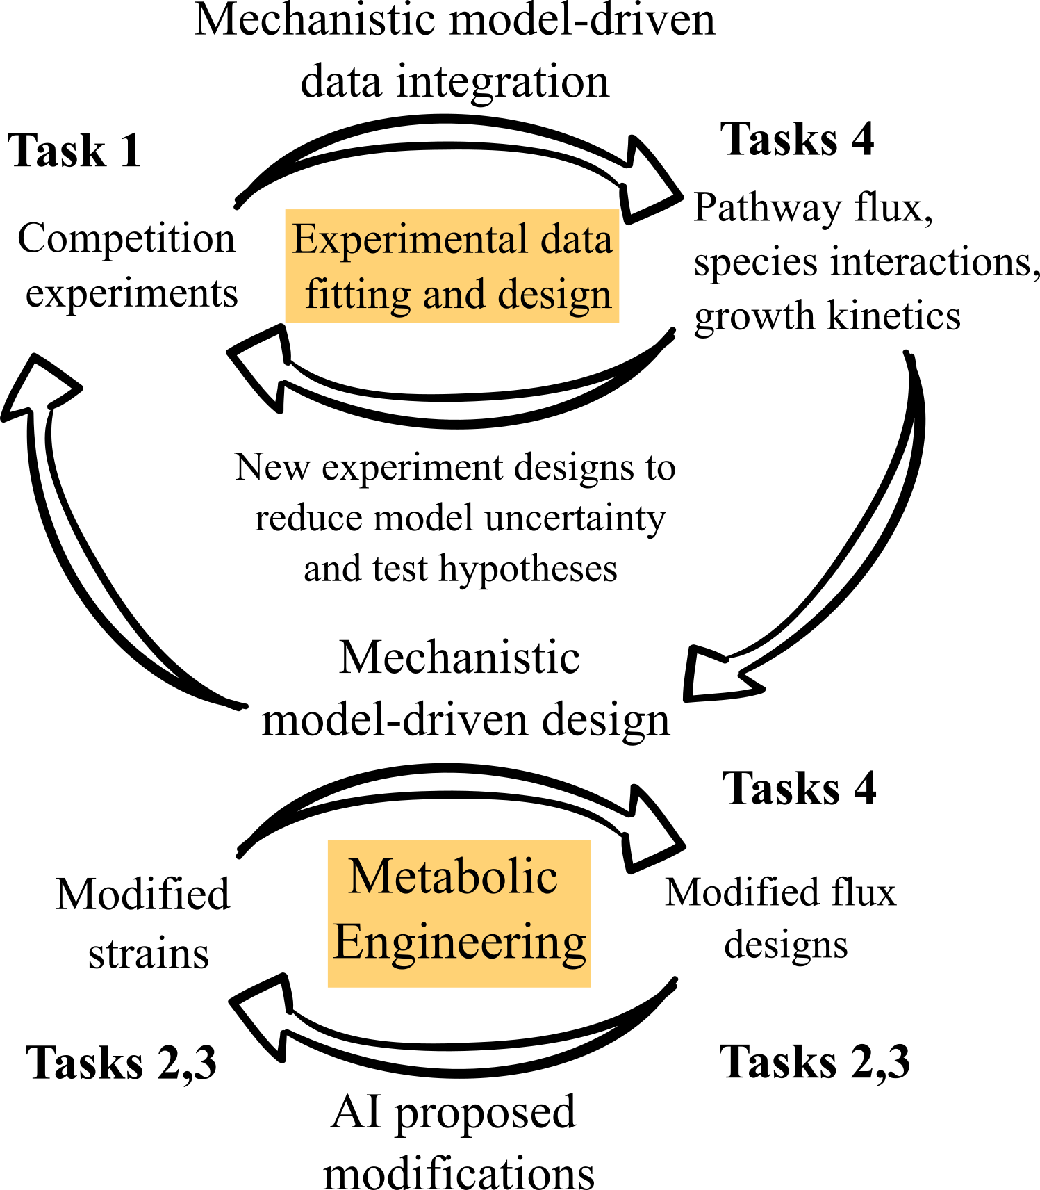
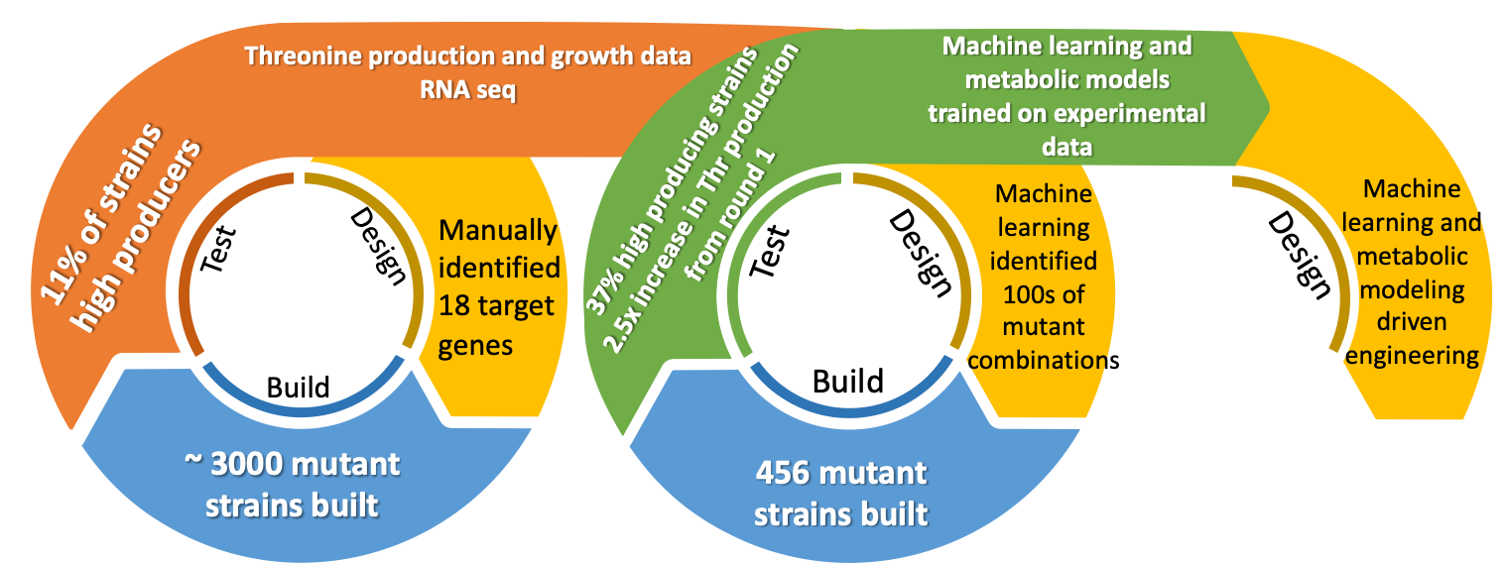
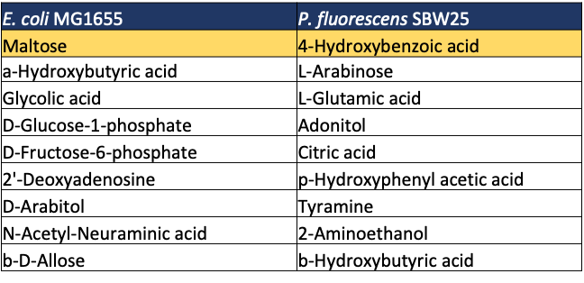
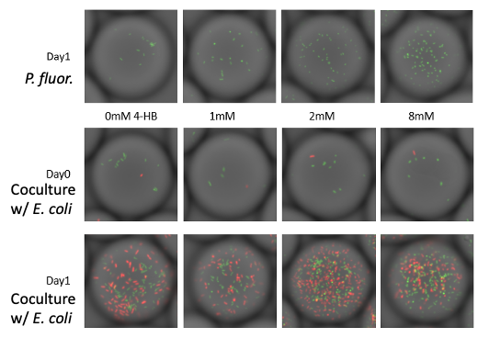



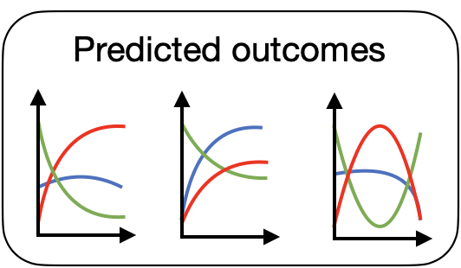
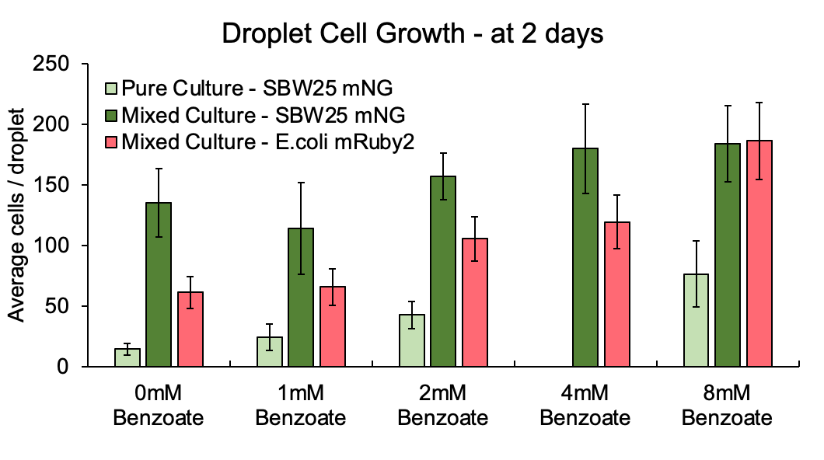






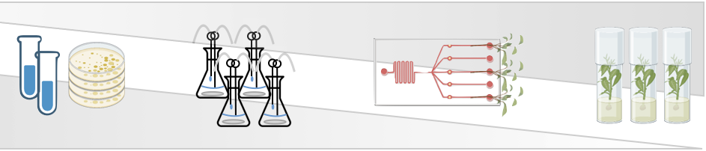




DEVELOPING “SMART” SINGLE-STRAIN SYSTEMS CAPABLE OF DETECTING AND RESPONDING TO TARGET ORGANISMS IN THE ENVIRONMENT
Jeffrey Dewey¹ (jdewey@anl.gov), Fatima Foflonker,² Andrew Freiburger,² Gyorgy Babnigg^{1*} (gbabnigg@anl.gov), Michael Fonstein,¹ Christopher S. Henry,² Jessica L. Johnson,¹ and Dionysios A. Antonopoulos¹
¹Biosciences Division, Argonne National Laboratory, Lemont, IL; ²Data Science and Learning Division, Argonne National Laboratory, Lemont, IL;
GOALS INTRODUCTION - AIM 1
COCULTURE METABOLISM
Numerous batch studies have been performed on a wide range of maltose, acetate, and 4-HB concentrations using various combinations of E. coli and P. fluorescens. We applied our modeling approach to fit all available data simultaneously, successfully predicting even complex competitive growth profiles involving multiple species. Once fit, model-based growth profiles fit experimental data very well as shown in the plot on the left, which depicts a specific experiment with competitive growth of E. coli and P. fluorescens on maltose as the sole carbon source. Although P. Fluorescens cannot use maltose, it grows on a byproduct from E. coli, acetate. This is quantitatively predicted by the model. We applied these models first to predict how E. coli could be modified to reduce excretion of acetate. We will next apply these models to quantify uncertainty and identify what new data can be gathered to reduce uncertainty (e.g. gene expression or metabolite concentrations at specific time-steps).
Batch experimental results with model fitting
(A)
(B)
MODELING INTRODUCTION
An ultimate goal of this SFA is to rationally re-engineer the behavior of a microbial community through the introduction of a custom tailored strain. To advance this goal, we are developing a mechanistic modeling approach that integrates large-scale diverse experimental datasets to understand detailed genome-scale metabolic flux and dynamic species interaction profiles within a microbiome. This approach translates data on the metabolic capabilities of all strains within a system and experimental data in the form of biomass, metabolite, and expression profiles into fully parameterized dynamic models of strain behavior. These dynamic models, which are optimized simultaneously to fit all experimental data, can then be applied predictively to design new microbiome behaviors, guiding us in learning how to modify our “actor” stain to alter microbiome behavior in a desired way.
Once our models are used to define new desired strain behaviors, we have also developed a combined mechanistic modeling and machine-learning approach to rapidly implement the desired behaviors within our strain.
Figure 3. Chemostat coculture experiments impact metabolic cross-feeding. (A) Example of a several day chemostat experiment run at 0.3 vol/hr dilution rate and 10 mM maltose in M9 media as the sole carbon source. The steady state percentage of P. fluorescens in the population remained between 5-10% after initial equilibraition. (B) E. coli coculture percentage after 72h of flow in chemostats fed with different 10 mM maltose and different concentrations of 4-hydroxybenzoate.
MODEL AND MACHINE-LEARNING APPROACH TO ENGINEERING
To engineer desired modifications in our “actor” strain, we developed an iterative model and machine-learning approach, which we demonstrated by engineering E. coli to have greater metabolite (threonine) production. In this approach, mechanistic models first accurately predict small strain modifications which are implemented individually and also combined randomly (growth, threonine production, and RNAseq data collected for all strains).
Machine learning models are trained from initial data to predict optimal combinations of modifications to improve threonine production.
While mechanistic models fared poorly at predicting successful combinations of changes, ML was extremely successful, greatly boosting threonine production.
INITIAL COCULTURE EXPERIMENTS
(A)
(C)
ß
FUTURE APPLICATIONS
(B)
Figure 2. Initial carbon source profiling and coculture experiments. (A) Unique carbon sources for E. coli and P. fluorescens as determined by BIOLOG growth assays. (B) Droplet-based cell culture quantification of P. fluorescens alone or in coculture with E. coli after two days culture with a constant maltose concentration (20 mM) and increasing 4-hydroxybenzoate concentration in M9 media. (C) Microscope imaging of droplet growth with each droplet containing ~60 μL of media.
We are now applying our predictive dynamic mechanistic models to design E. coli modifications to enhance competition with P. fluorescens in a range of media and growth conditions (chemistat/batch/2D plate). Modifications include addition of new metabolic modules, gene deletions, and altered pathway expression profiles. Eventually, toxin production pathways will be explored as well. We also intend to add spatial dimensions to our model to permit design and prediction of spatial dynamic growth behavior. All data, models, and methods are also being integrated into the KBase environment, enabling other scientists to apply these approaches.

